Slide 1
First LEGO League
Basic Driving Base

Slide 2

First LEGO League
The FIRST LEGO League Challenge (formerly known as FIRST LEGO League) is an international competition organized by FIRST for elementary and middle school students
Each year in August FIRST LEGO League Challenge teams are introduced to a scientific and real-world challenge for teams to focus and research on.
The robotics part of the competition involves designing and programming LEGO Mindstorms robots to complete tasks.
The students work out a solution to a problem related to the theme and then meet for regional, national and international tournaments to compete, share their knowledge, compare ideas, and display their robots.
The FIRST LEGO League Challenge is a partnership between FIRST and the LEGO Group.

Slide 3
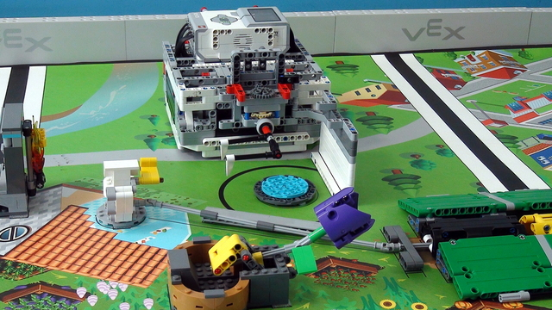
Robot Game Overview
Plan
Work together to design and build a LEGO robot
Program it to autonomously complete a series of missions
Score points in a 2.5-minute robot game.
Do:
Decide mission strategy
Launches robot
Robot moves around the field attempting to complete the missions.
The robot is programmed to return to home at anytime so the team can modify it before launching again to try other missions.
If needed, the robot can be brought back to home by hand, but the team will lose a precision token.
The team will have three robot game matches, but only their highest score will count.

Slide 4
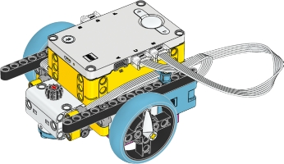

Slide 5

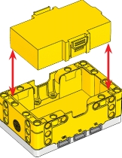
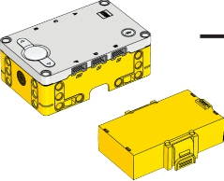


Slide 6
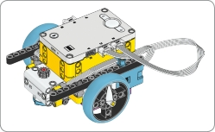
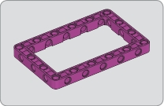
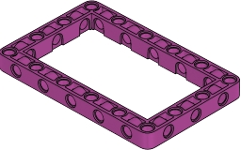
1x
1

Slide 7

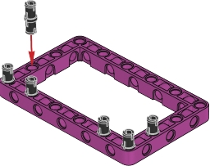
6x
2

Slide 8

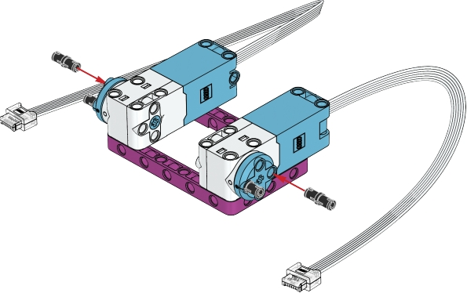

2x 4x
3

Slide 9

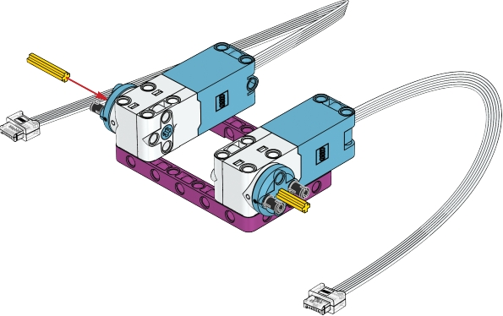
3
2x
4
3
3

Slide 10
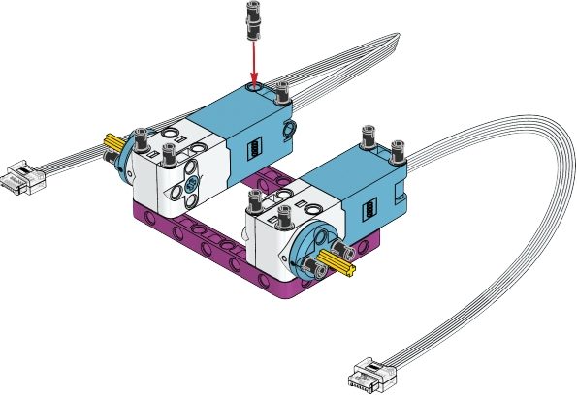
8x
5

Slide 11
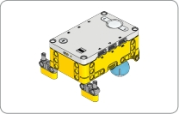
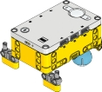
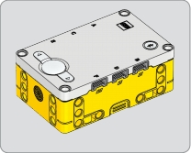
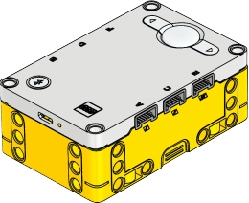
1x
6

Slide 12

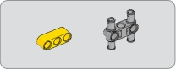



2x 2x
7

Slide 13
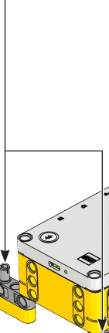
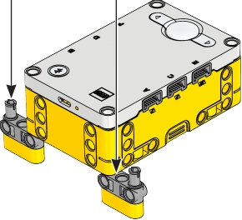
8

Slide 14

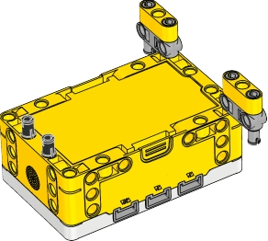
2x
9

Slide 15


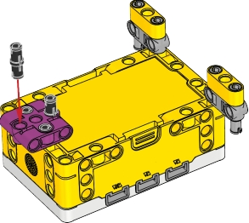
2x 1x
10

Slide 16



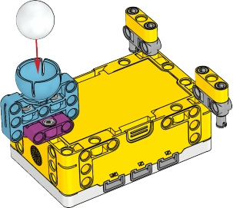
1x 1x
11

Slide 17

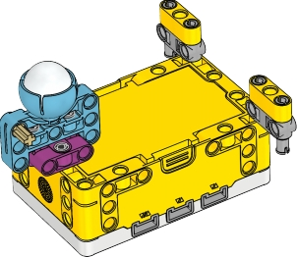
1x
12

Slide 18


1x
13

Slide 19
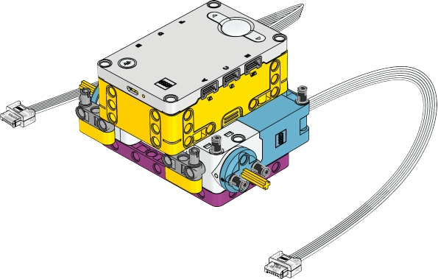

14

Slide 20


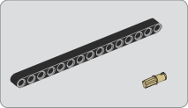
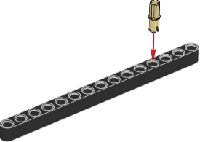
15
1x 1x
15
15

Slide 21
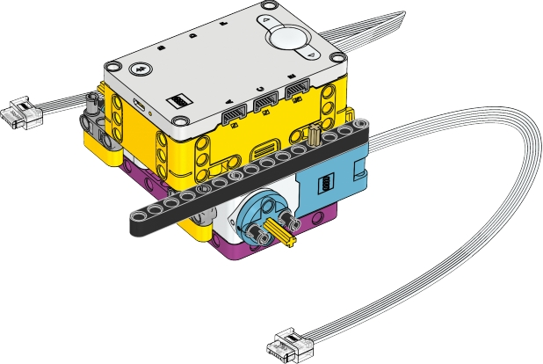
16

Slide 22

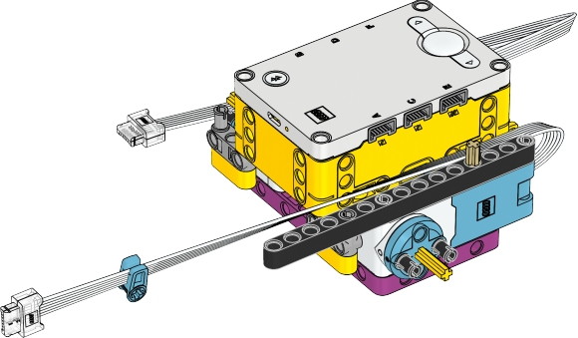
1x
17

Slide 23
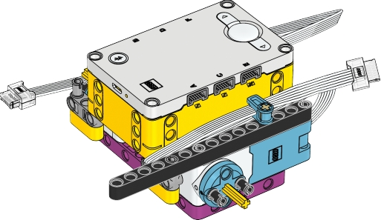
18

Slide 24
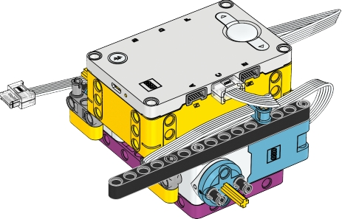
19

Slide 25


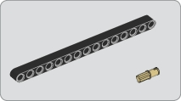

15
1x 1x
20
15

Slide 26
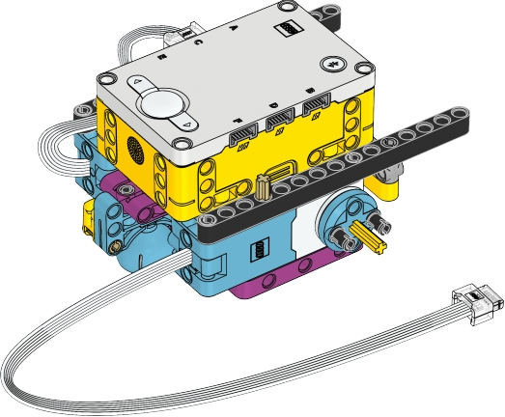

21

Slide 27

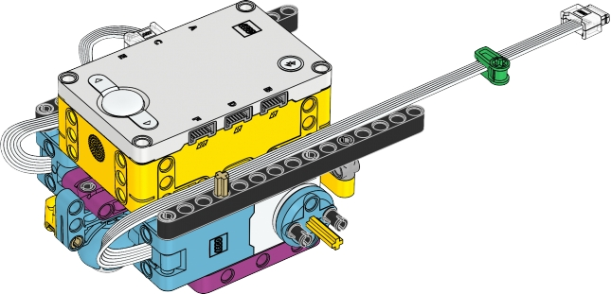
1x
22

Slide 28
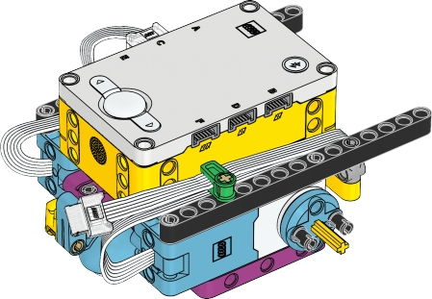
23

Slide 29
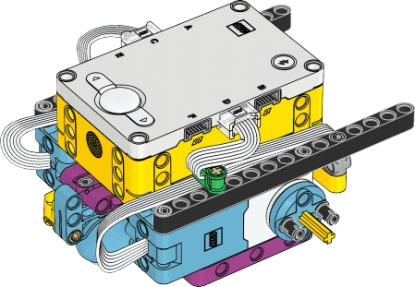
24

Slide 30



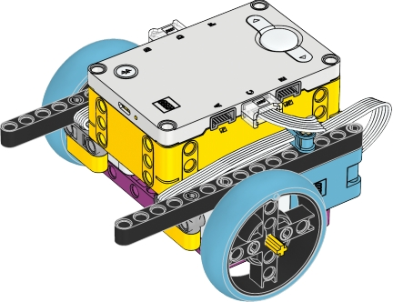
2x
25

Slide 31

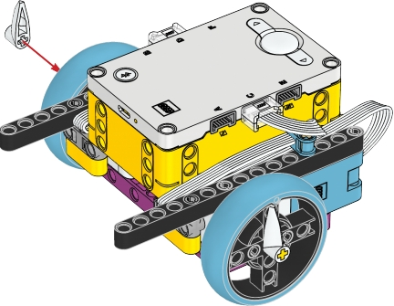
2x
26

Slide 32
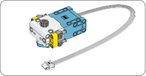
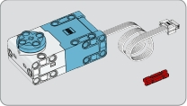
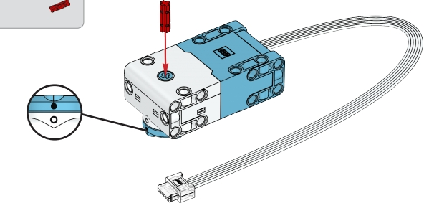
1x
1x
27

Slide 33

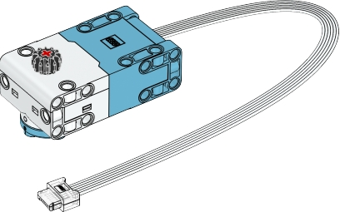
1x
28

Slide 34




2x 2x
29

Slide 35


4x
30

Slide 36

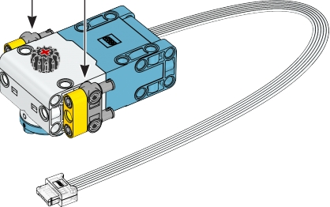
31

Slide 37
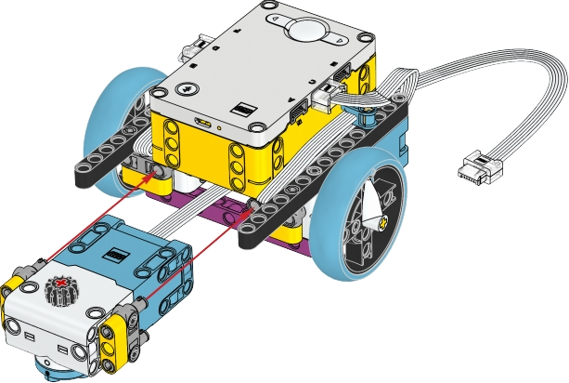
32

Slide 38

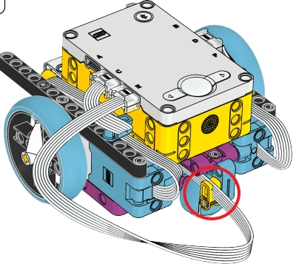
33

Slide 39


34

Slide 40
